Slide 1
Interplay of Vmax and alpha
Vmax most sensitive between 0.1 and 0.9
alpha is most sensitive between 2.0e-6 and 7.0e-6

Slide 2
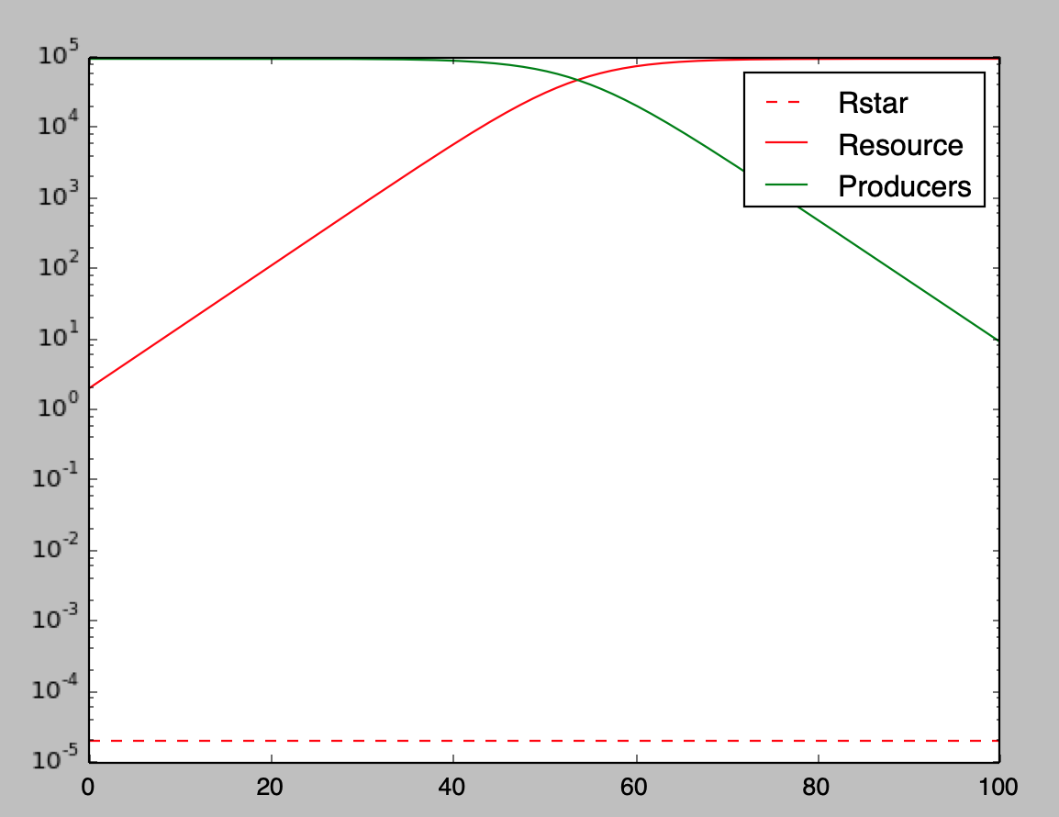
Alpha = 0.000002 Vmax = 10000000

Slide 3
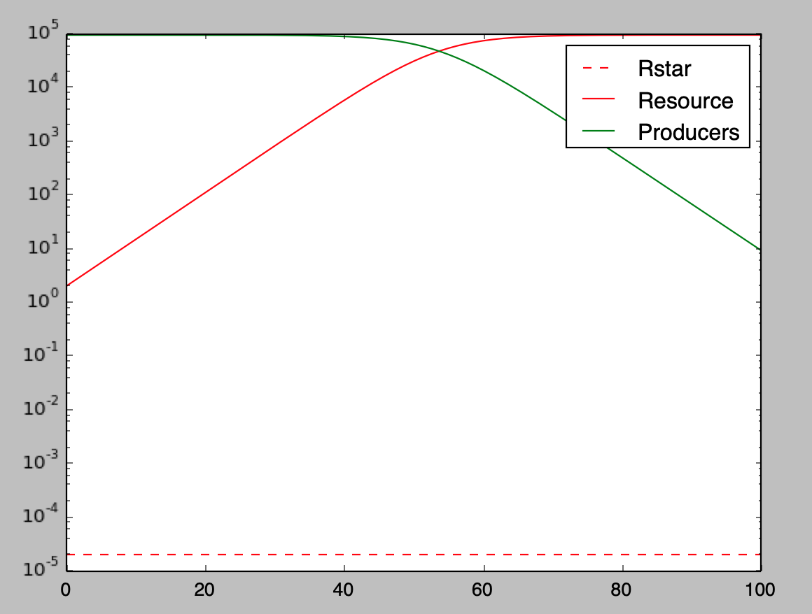
Alpha = 0.000002 Vmax = 1000

Slide 4
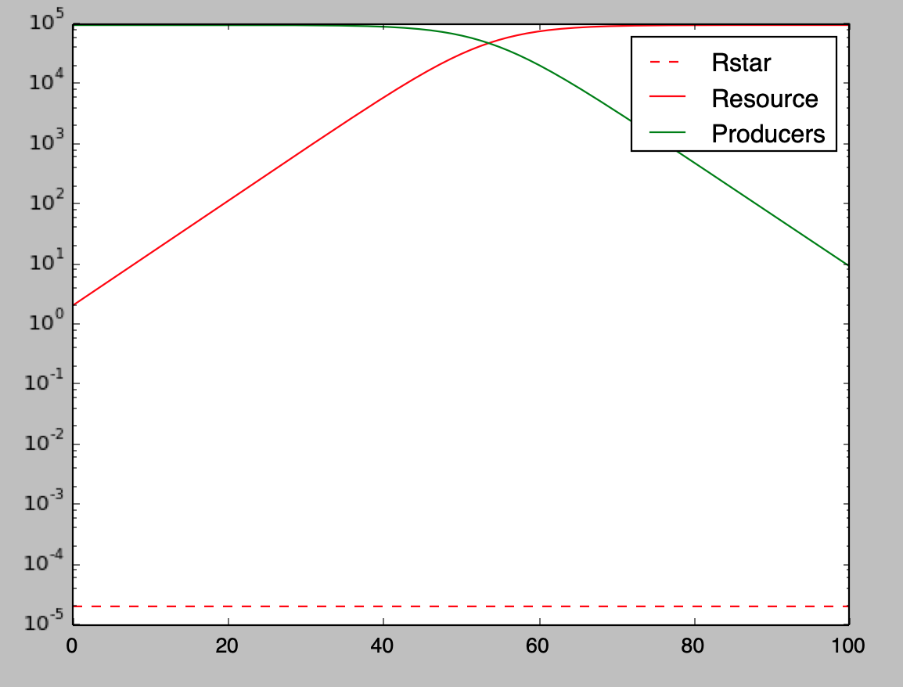
Alpha = 0.000002 Vmax = 100

Slide 5
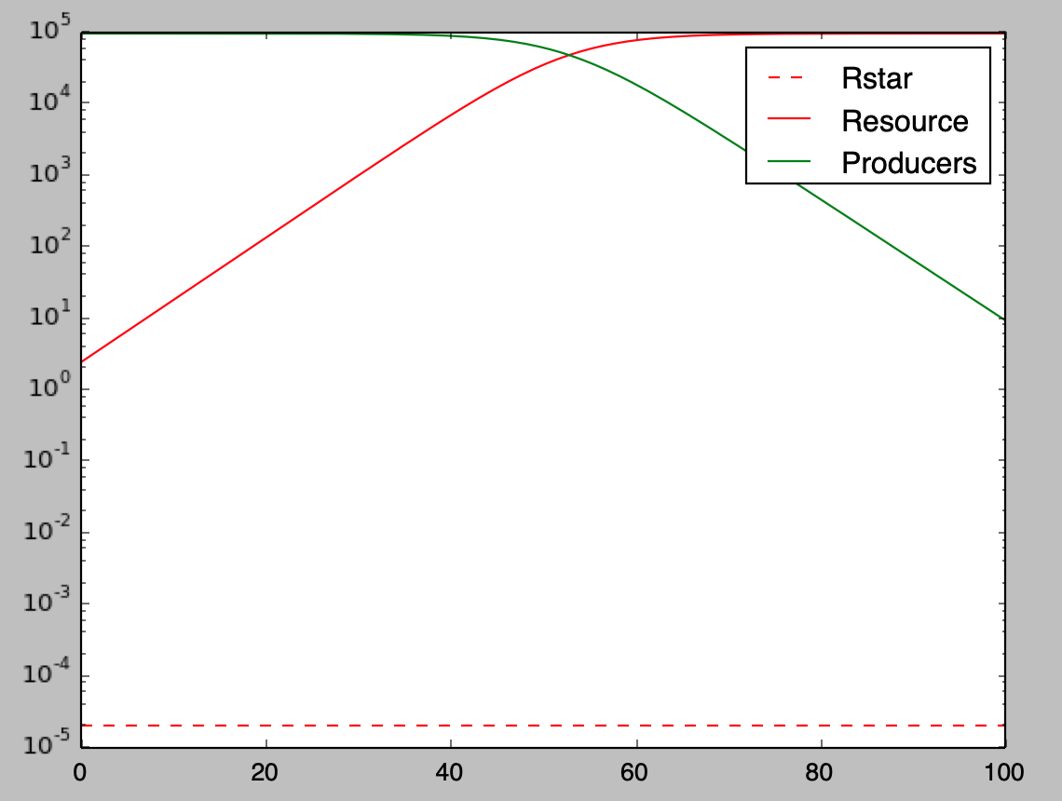
Alpha = 0.000002 Vmax = 10

Slide 6
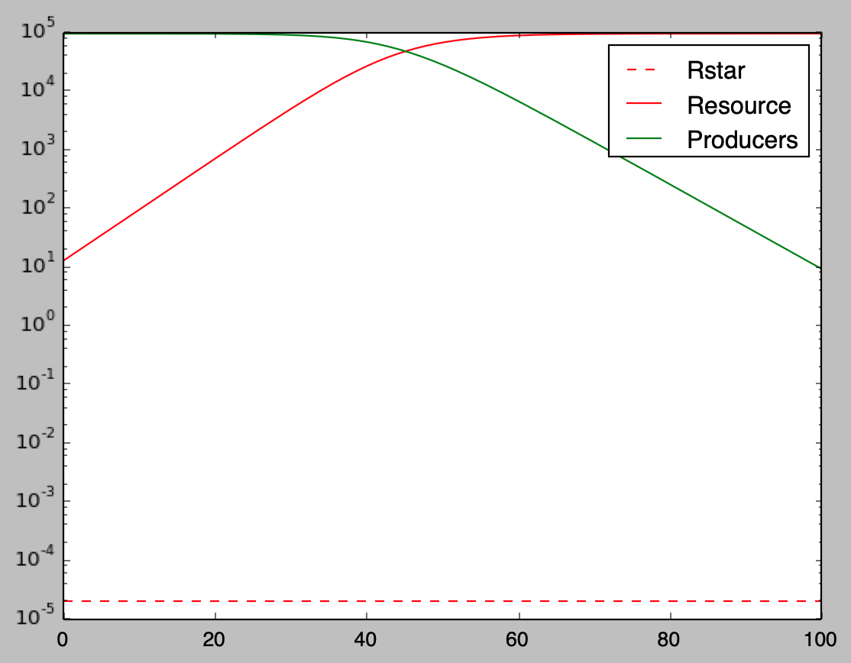
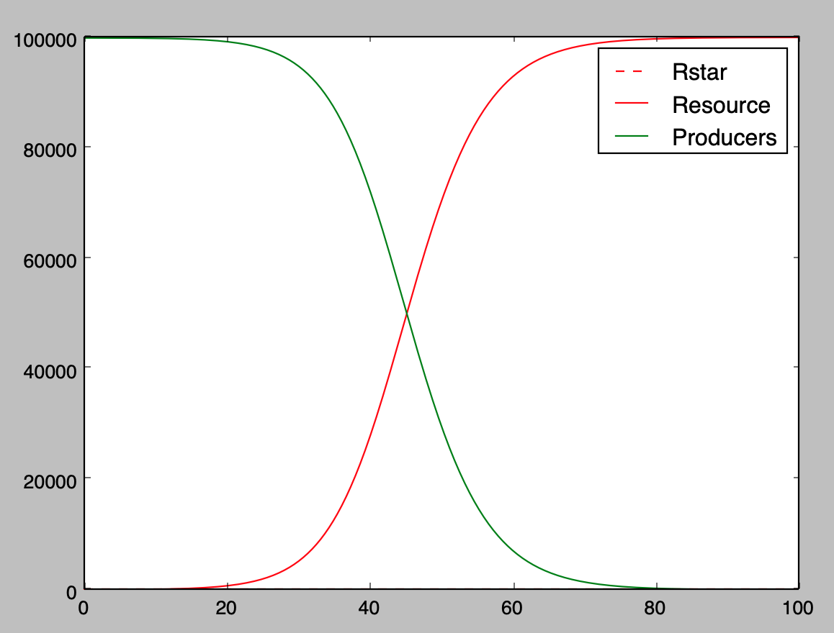
Alpha = 0.000002 Vmax = 1.0

Slide 7
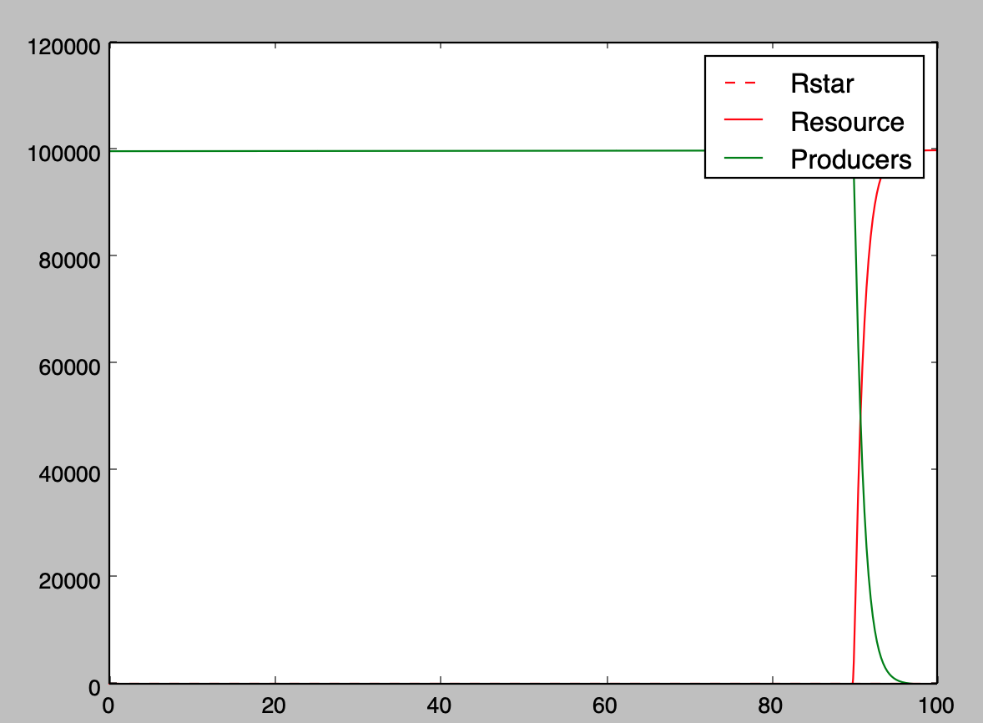
Alpha = 0.0002 Vmax = 1.0

Slide 8
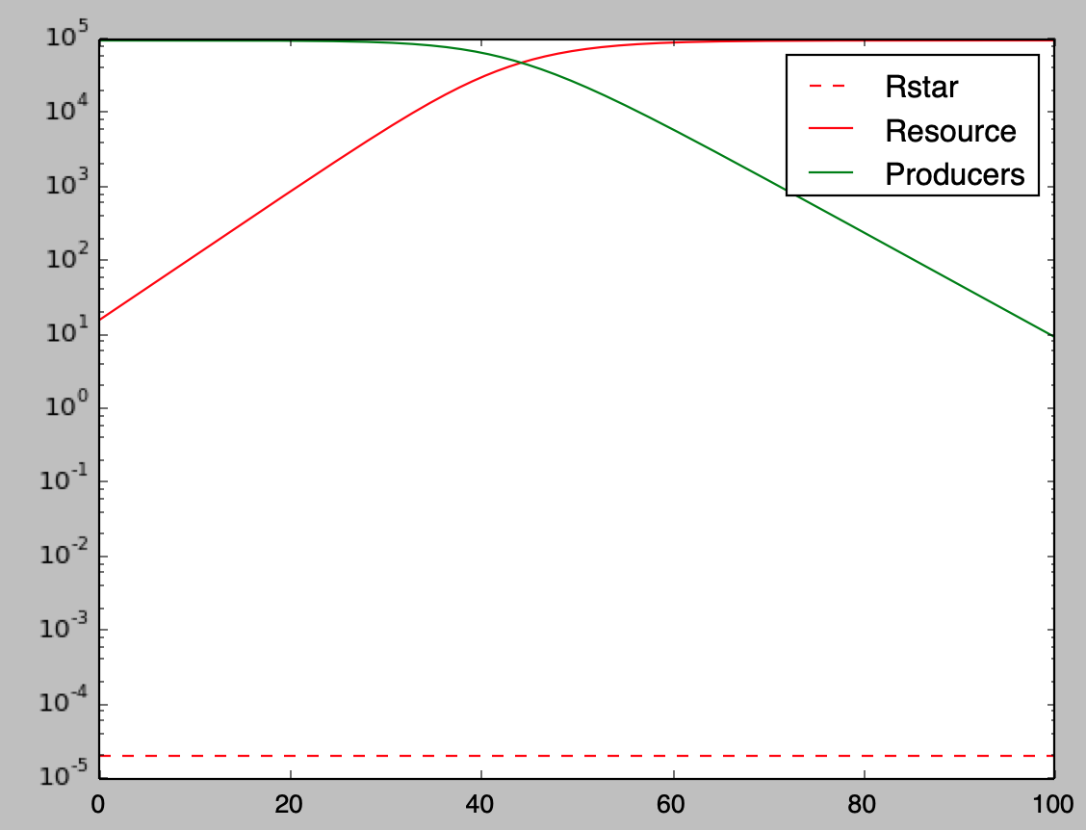
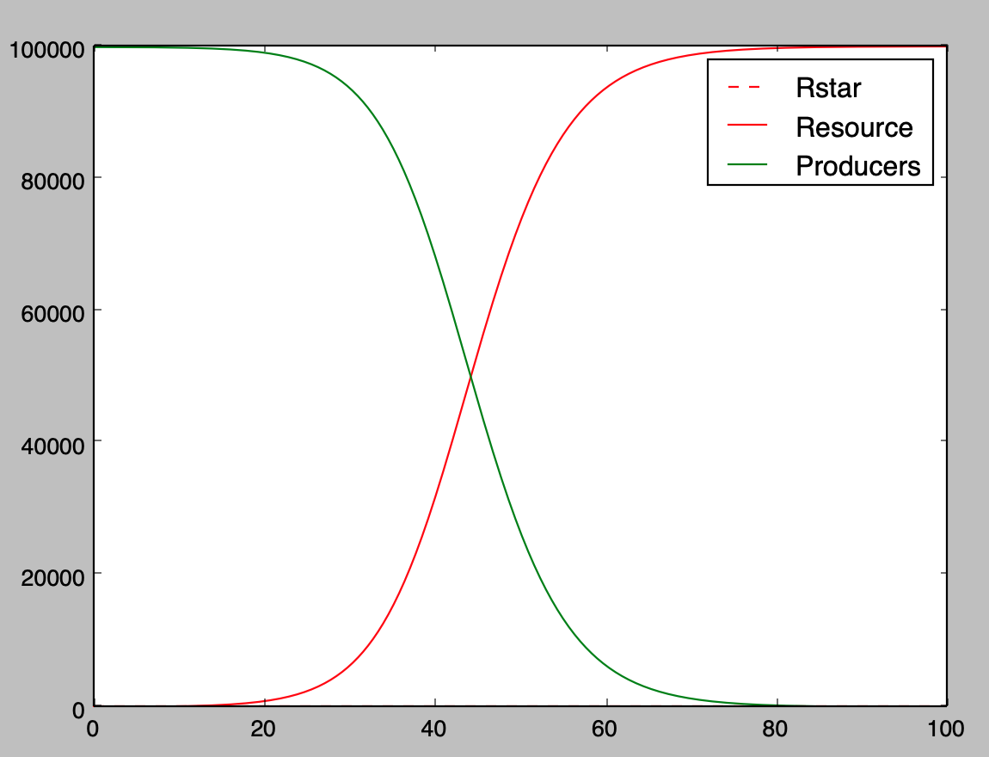
Alpha = 0.000002 Vmax = 0.9

Slide 9
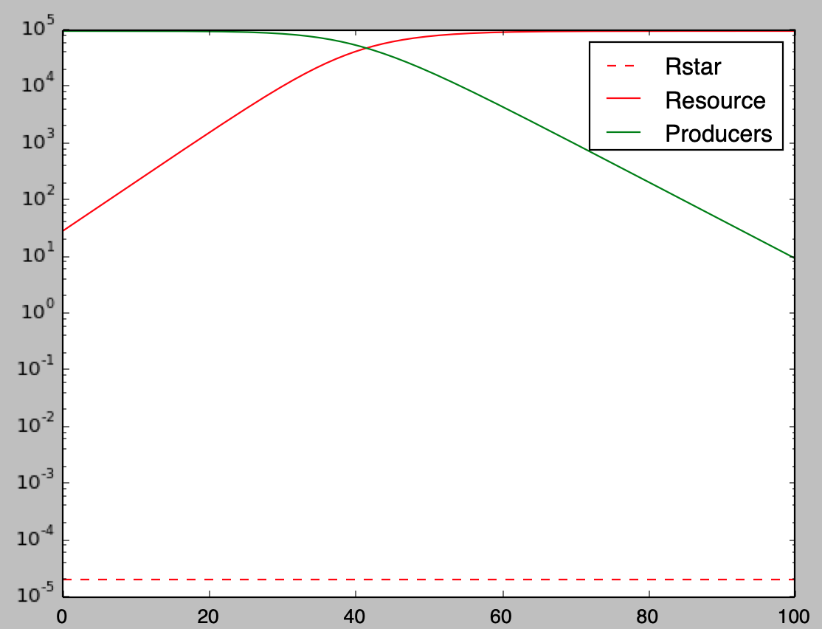
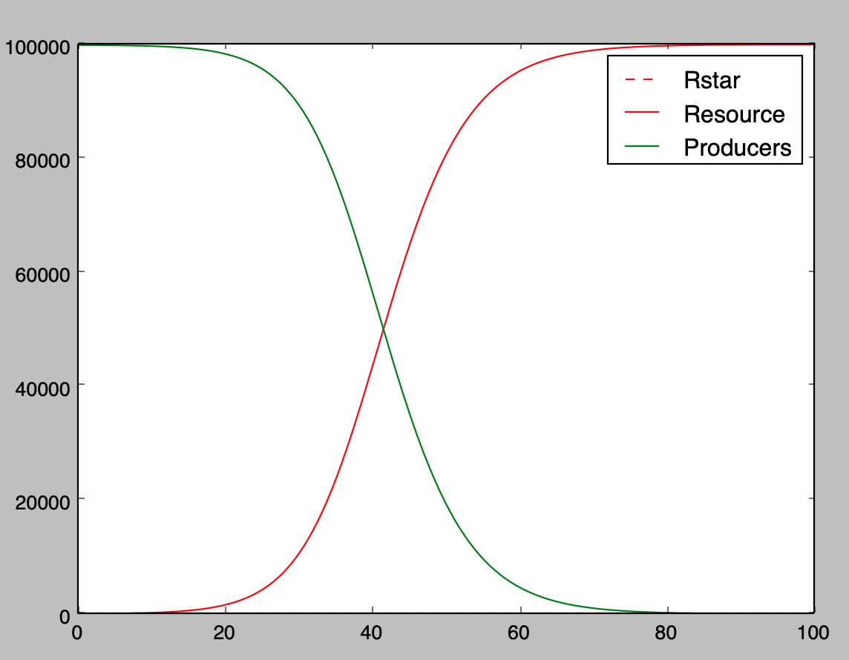
Alpha = 0.000002 Vmax = 0.7

Slide 10
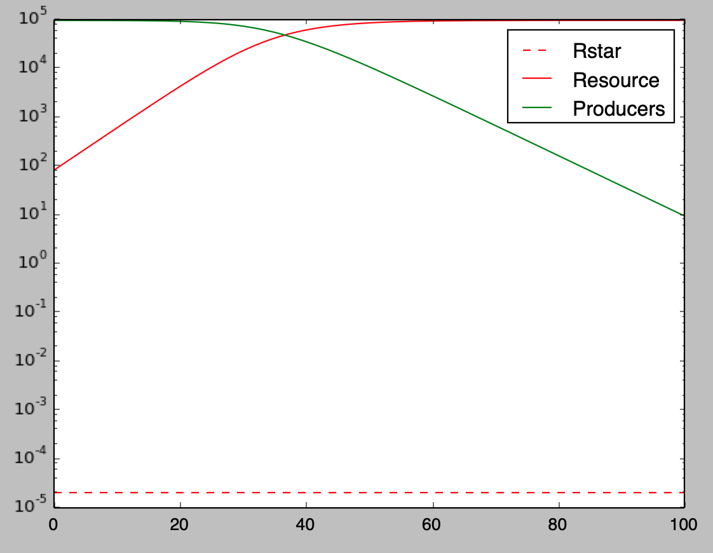
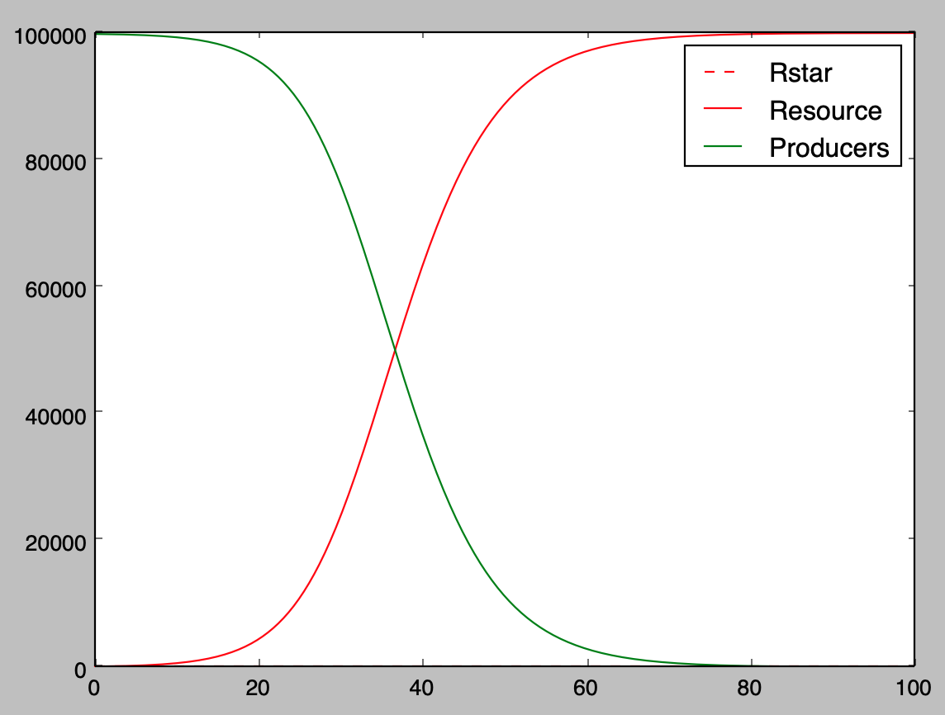
Alpha = 0.000002 Vmax = 0.5

Slide 11
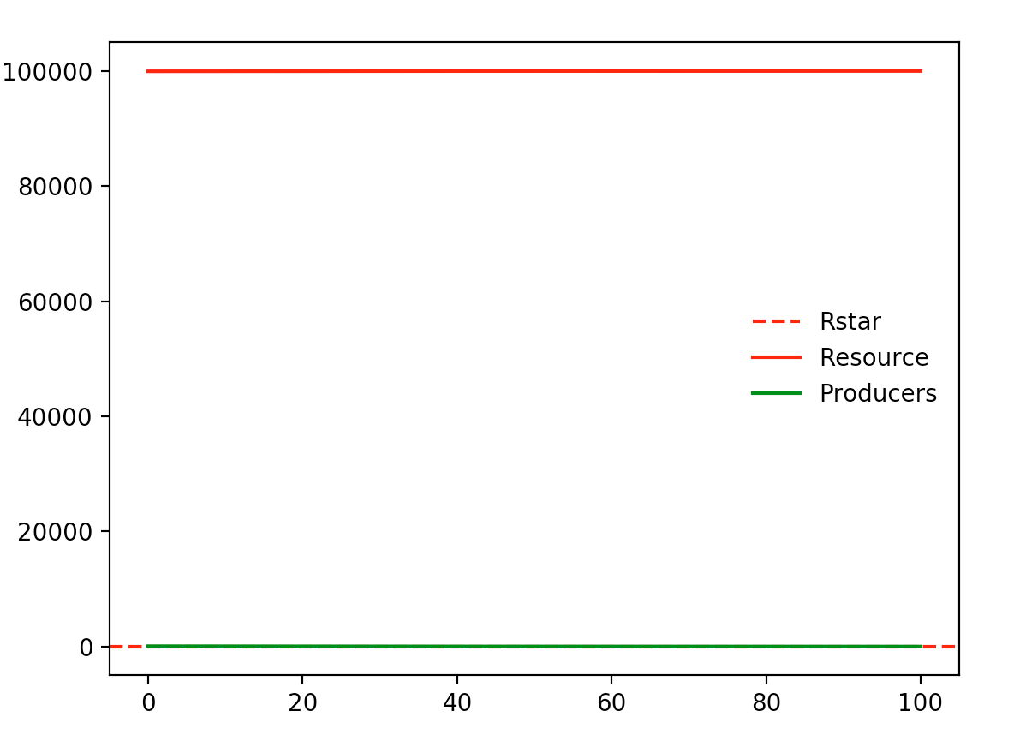
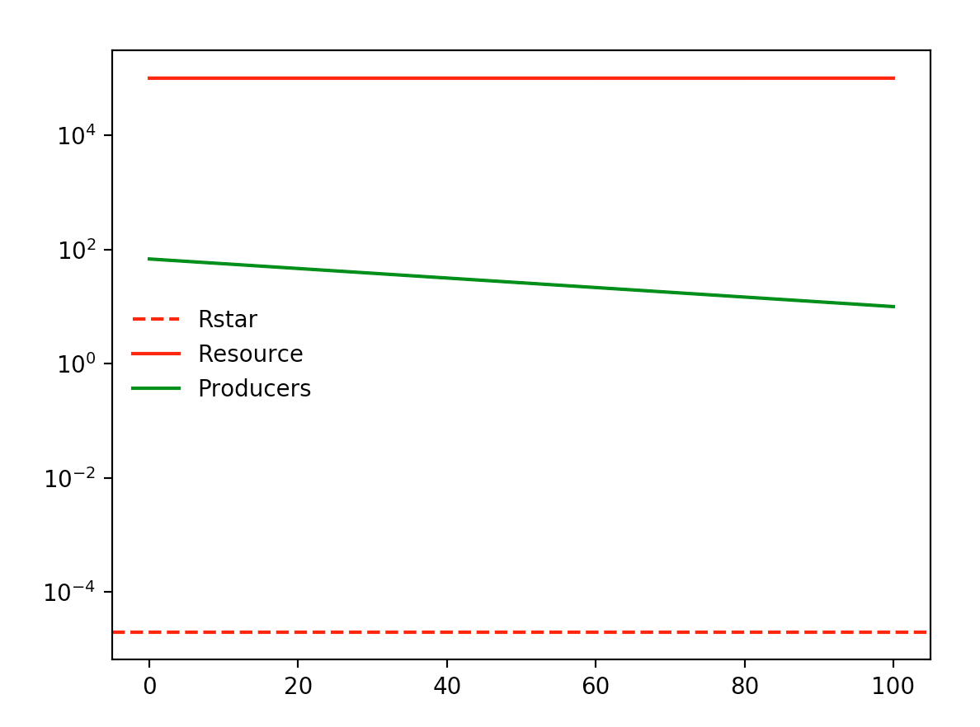
Alpha = 0.0000002 Vmax = 0.5

Slide 12
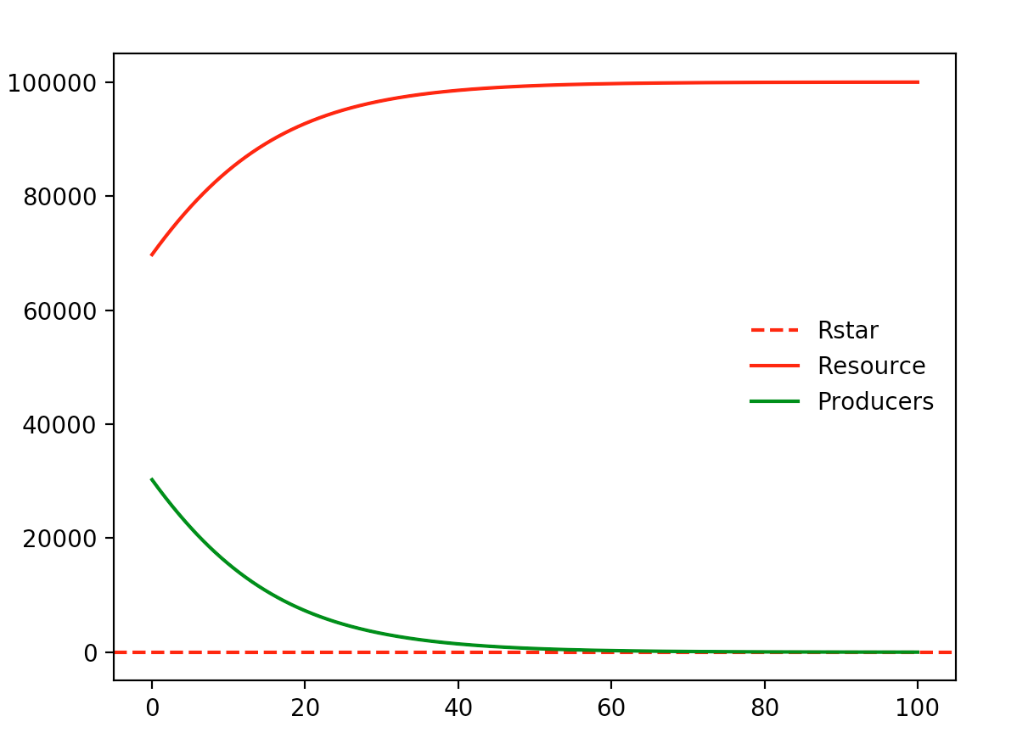
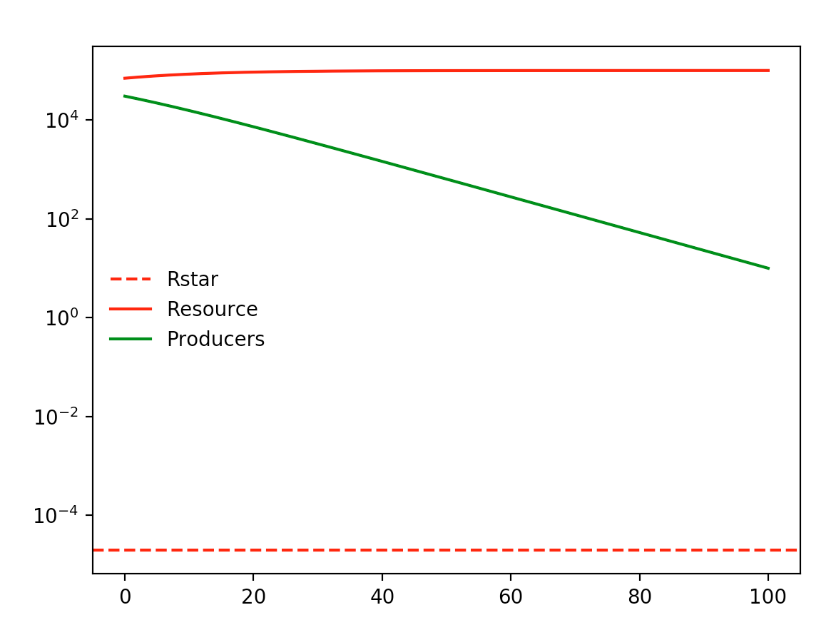
Alpha = 0.000001 Vmax = 0.5

Slide 13
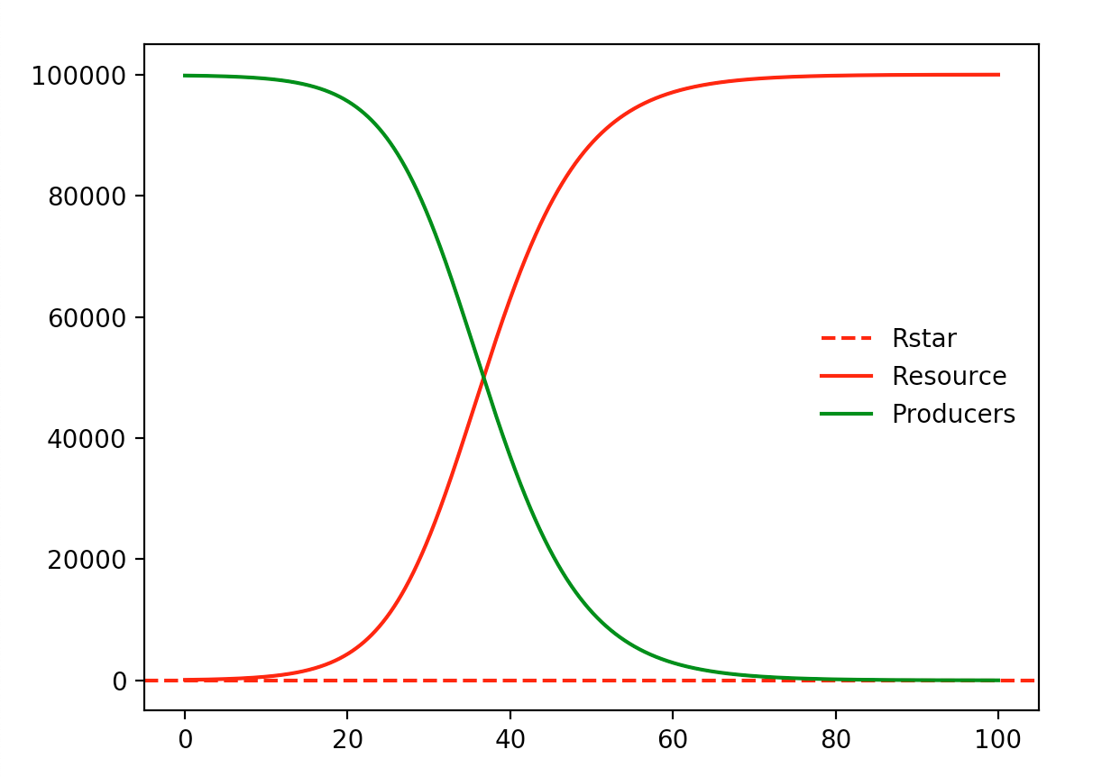
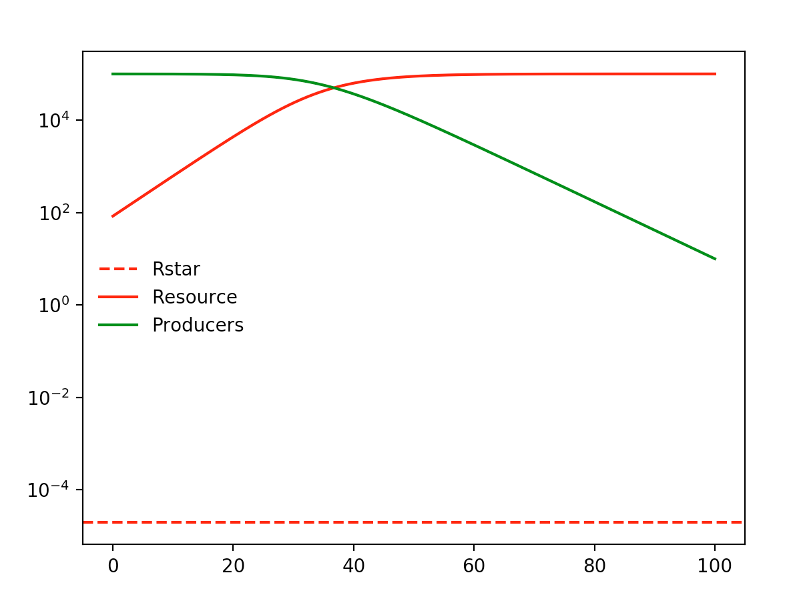
Alpha = 0.000002 Vmax = 0.5

Slide 14
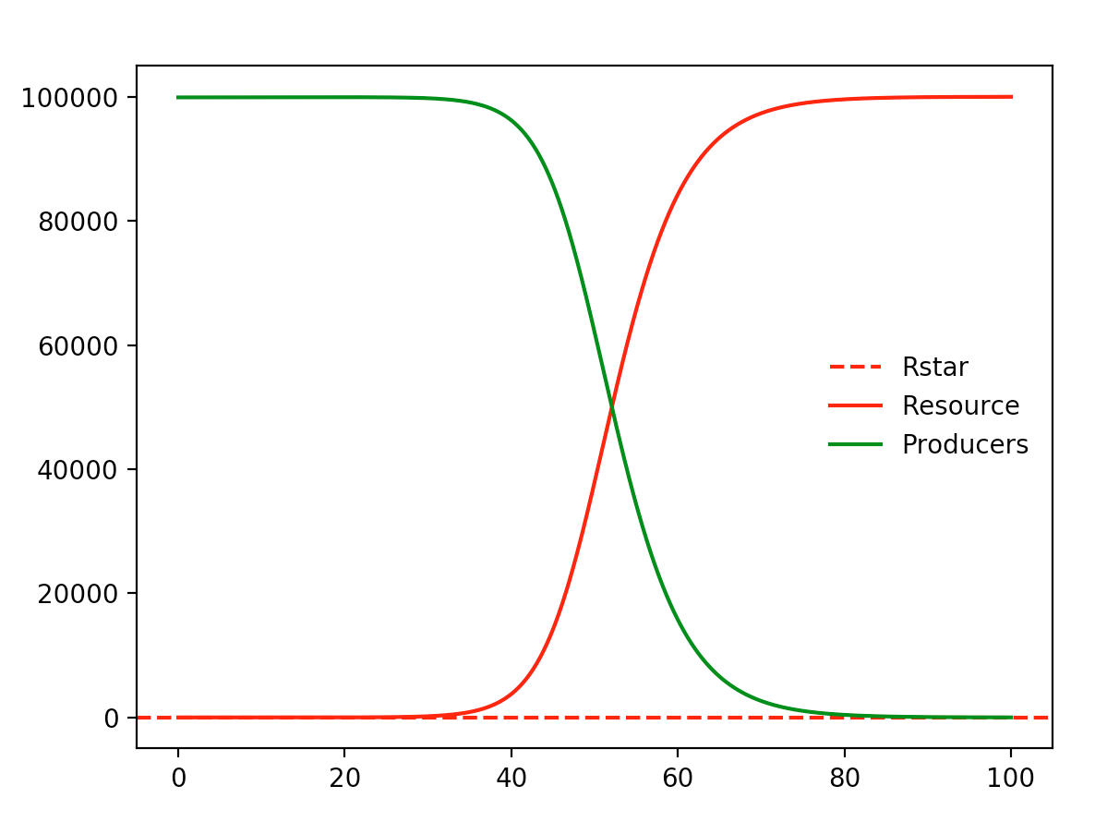
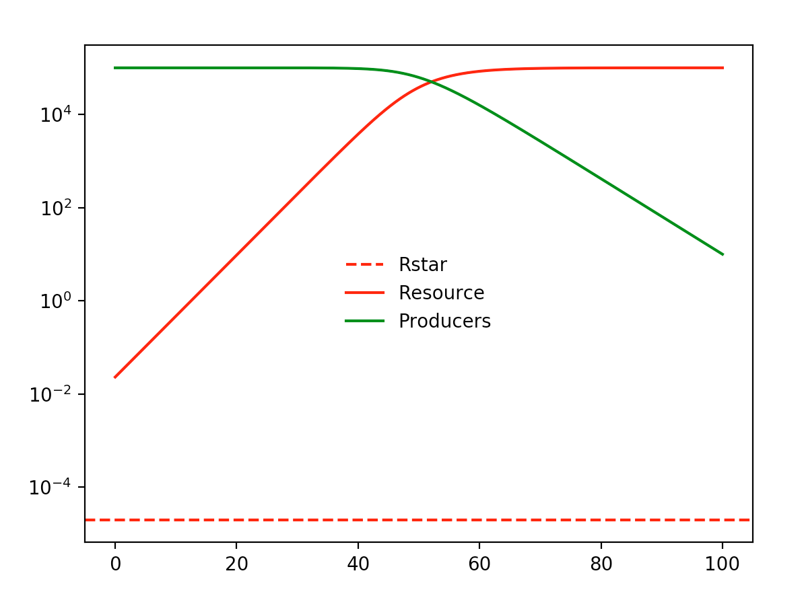
Alpha = 0.000003 Vmax = 0.5

Slide 15
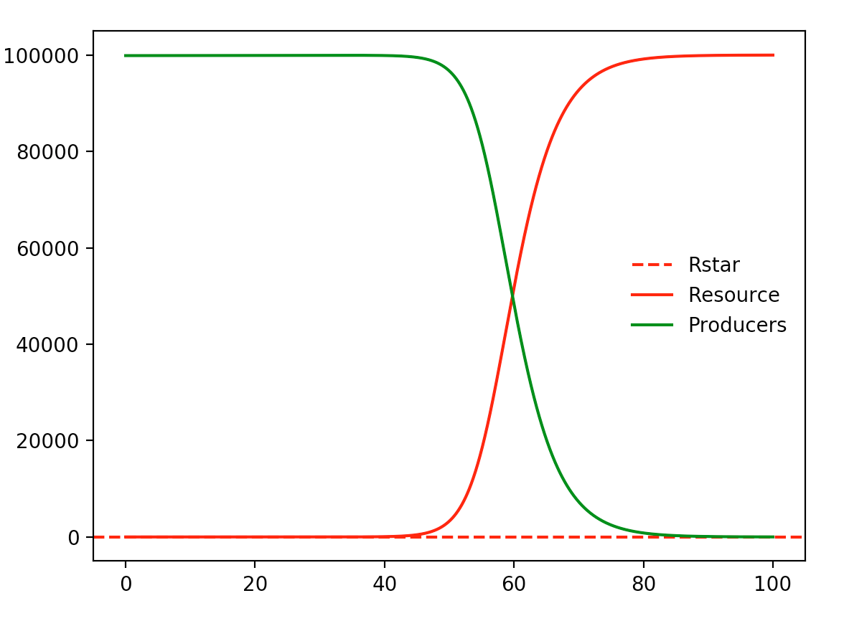
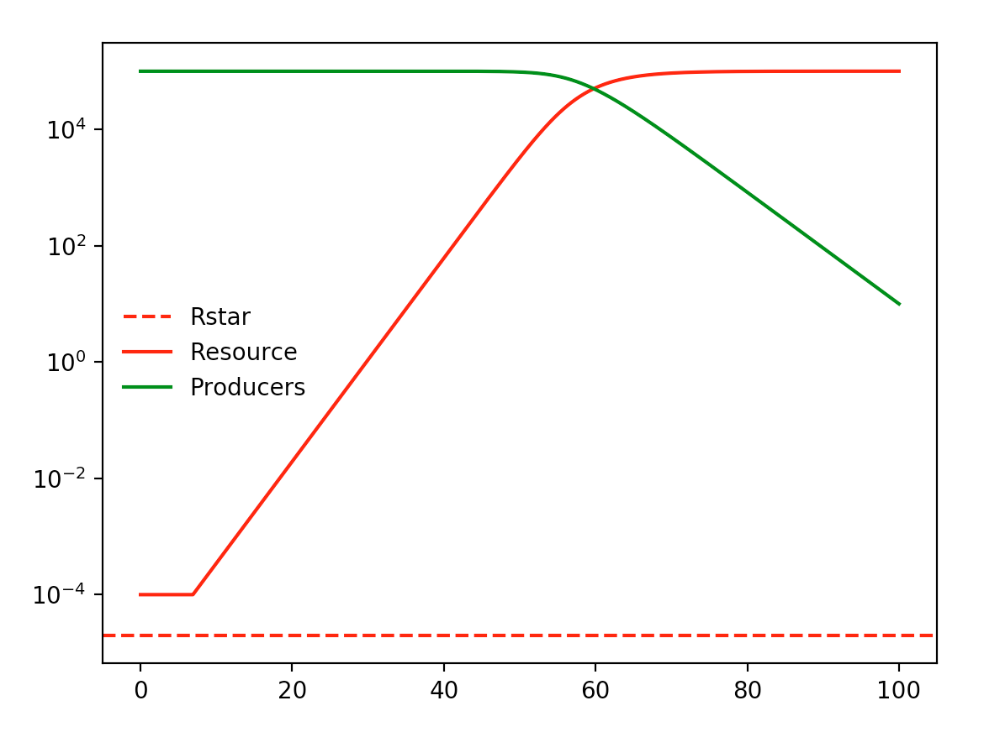
Alpha = 0.000004 Vmax = 0.5

Slide 16
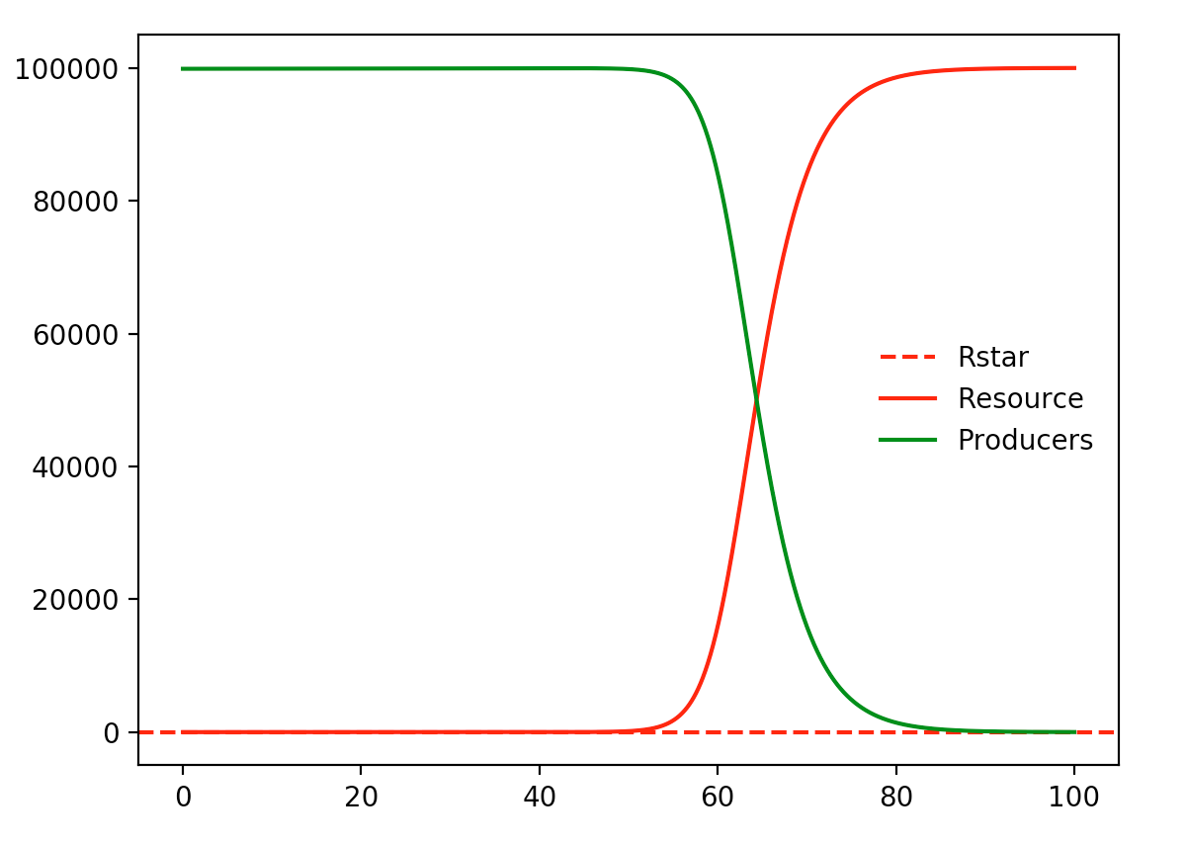
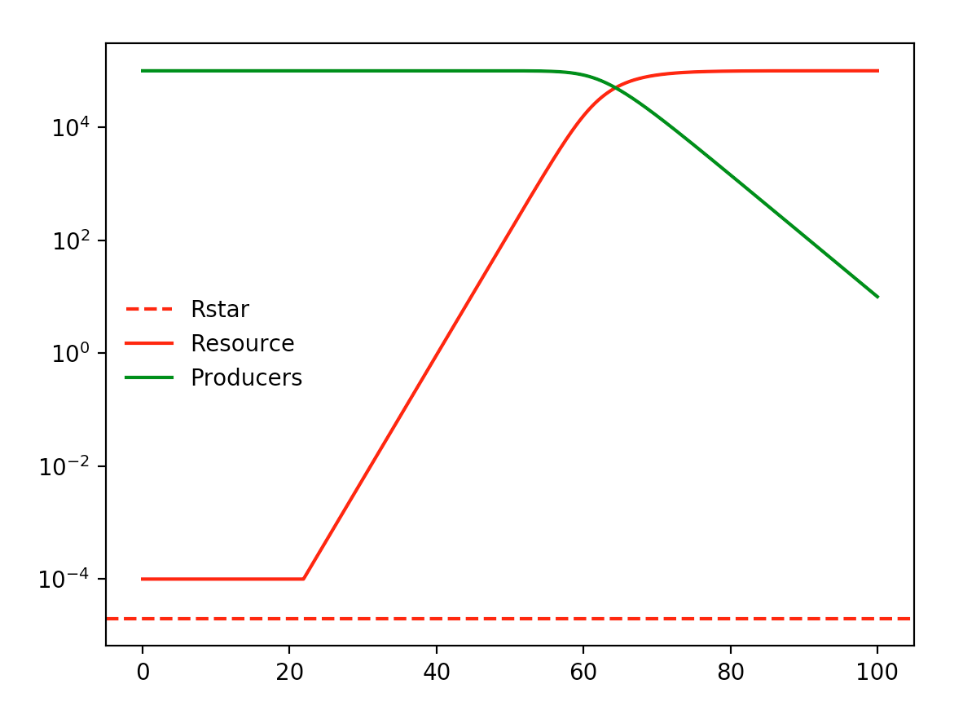
Alpha = 0.000005 Vmax = 0.5

Slide 17
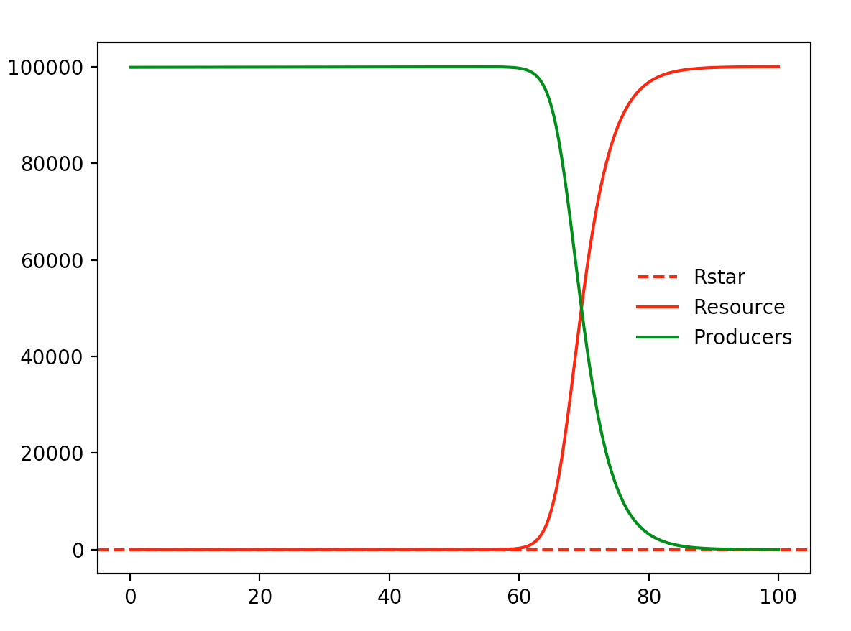
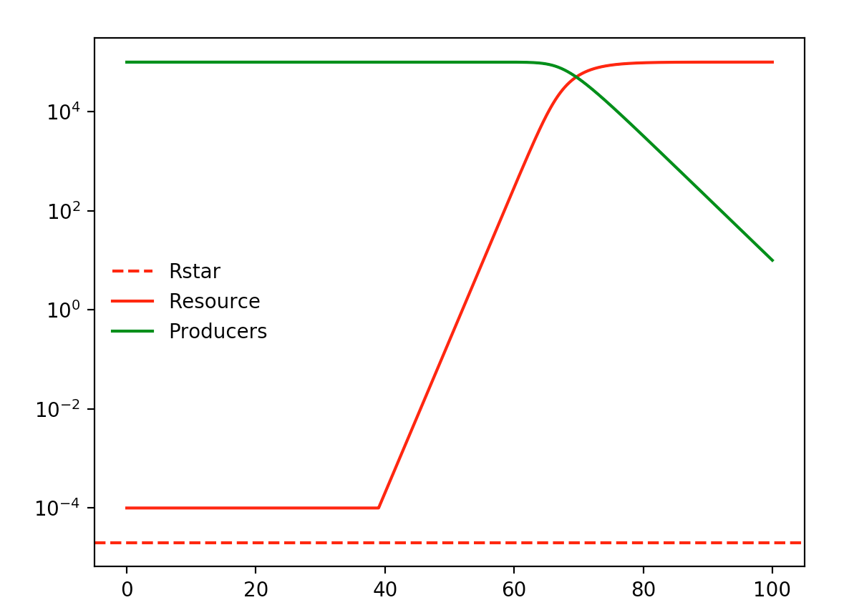
Alpha = 0.000007 Vmax = 0.5

Slide 18
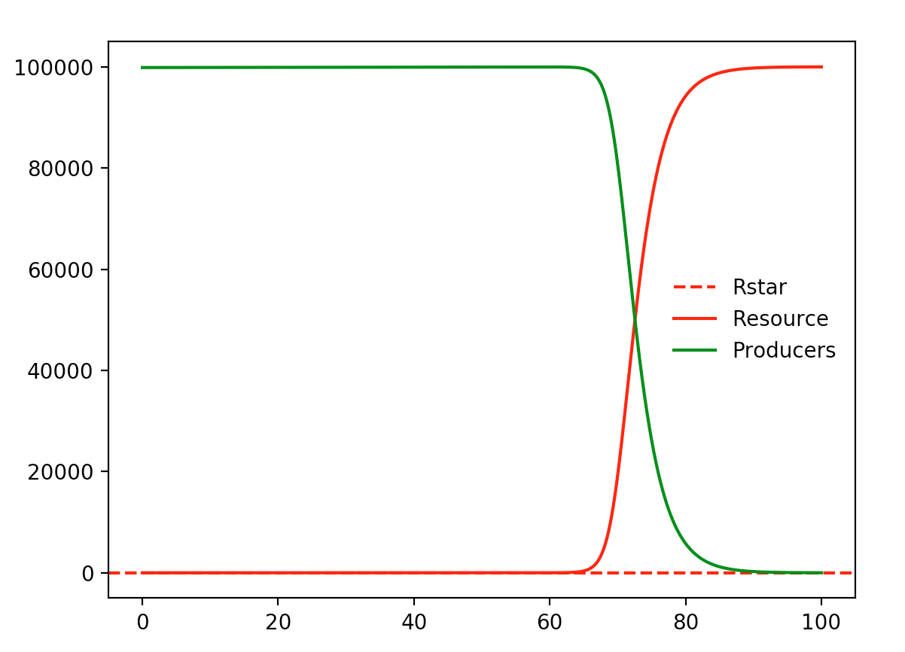
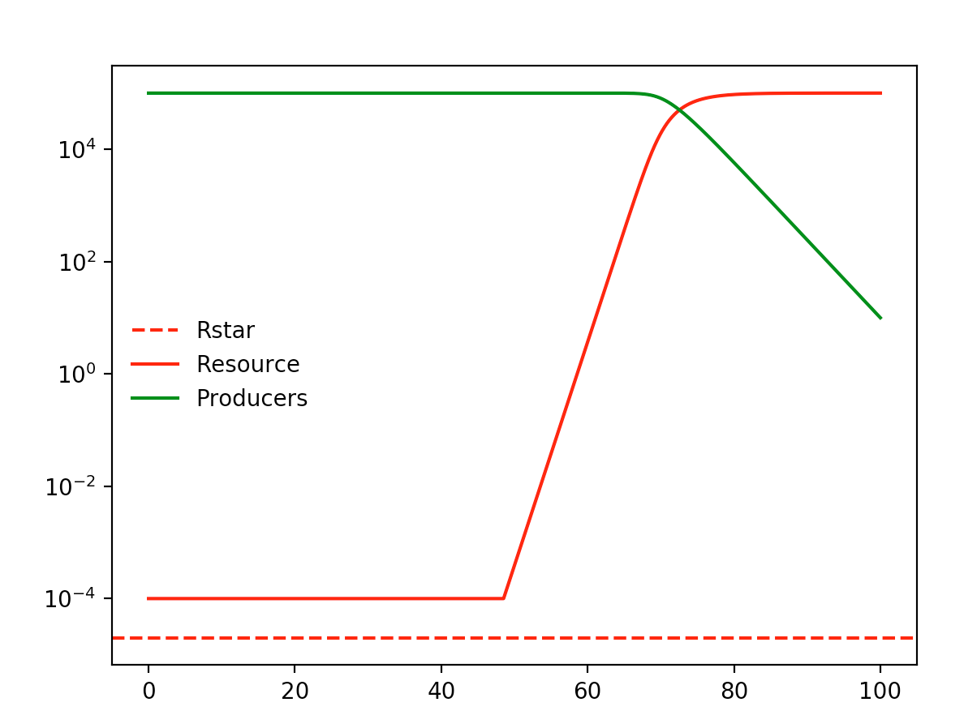
Alpha = 0.000009 Vmax = 0.5

Slide 19
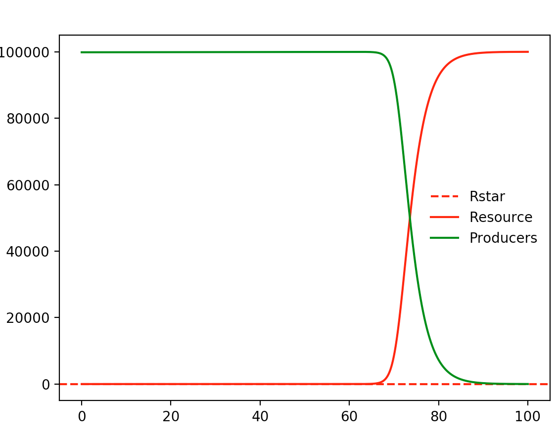
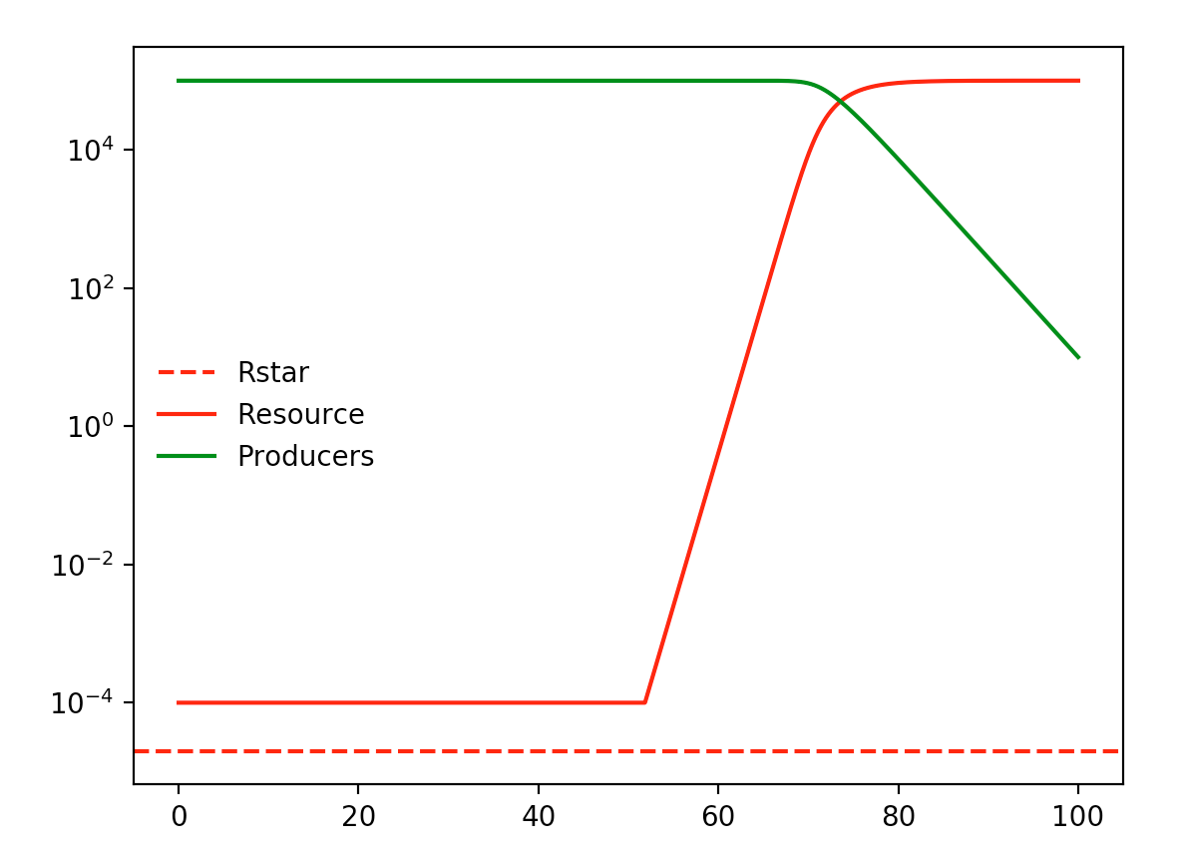
Alpha = 0.00001 Vmax = 0.5

Slide 20
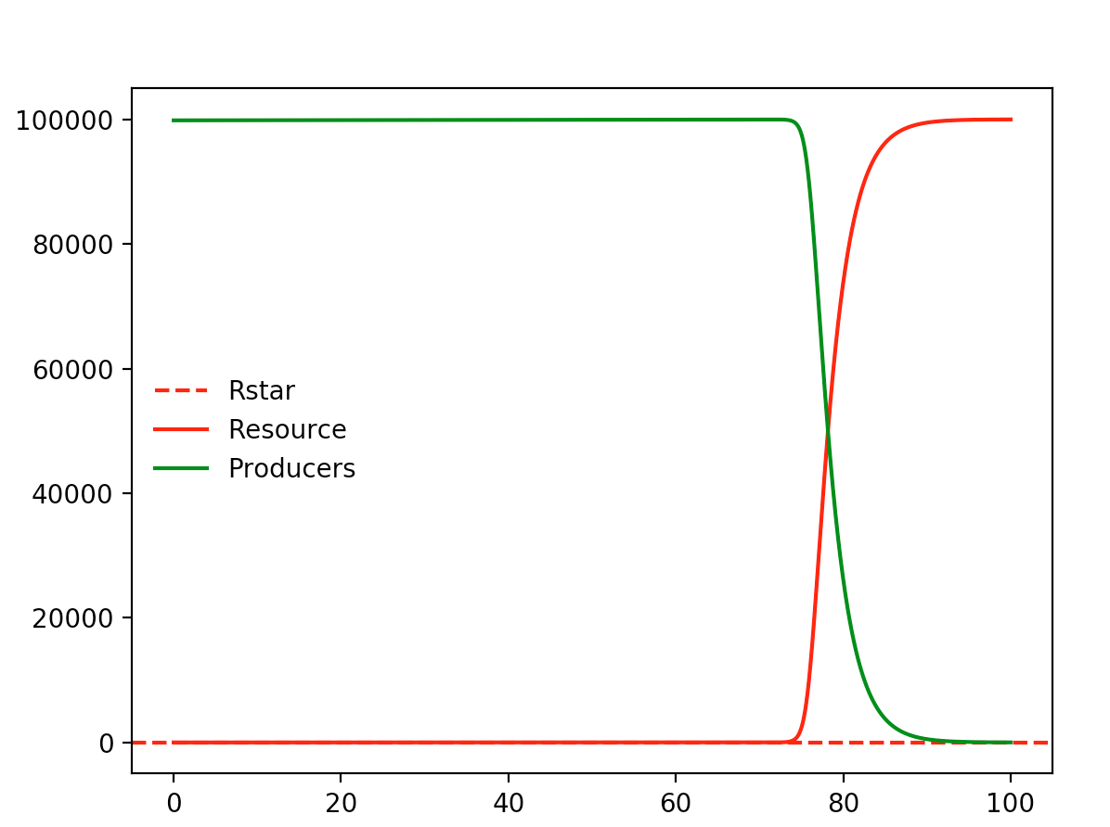
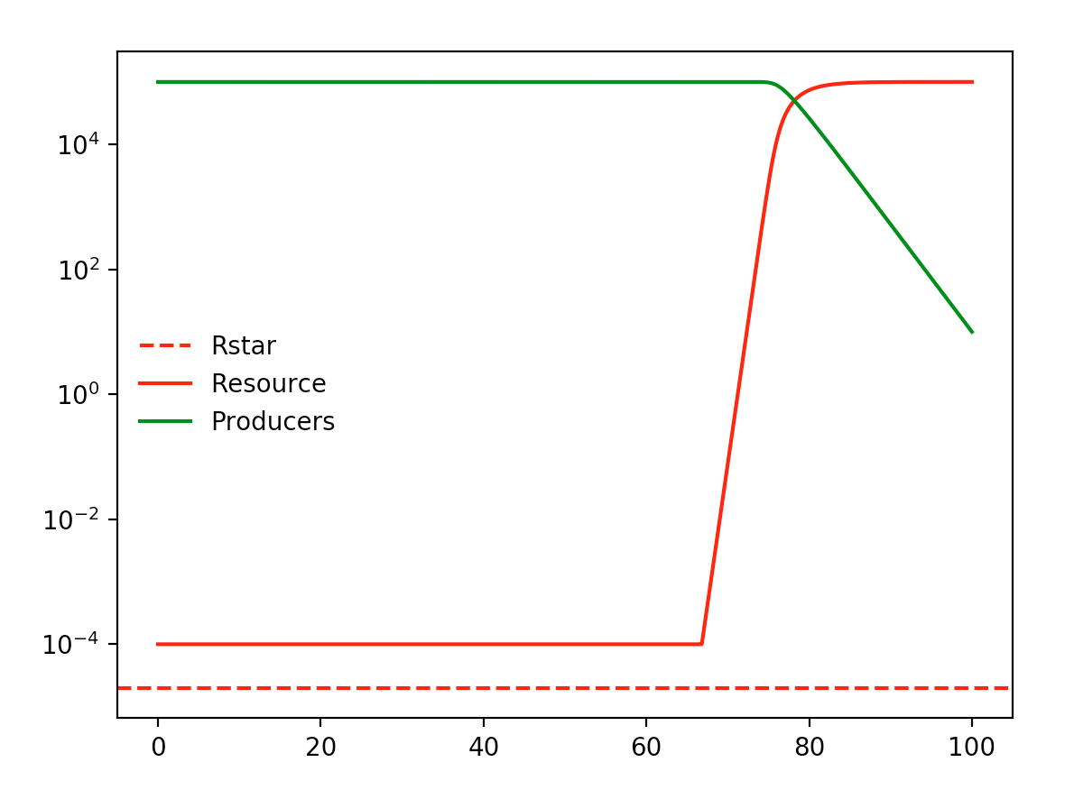
Alpha = 0.00002 Vmax = 0.5

Slide 21
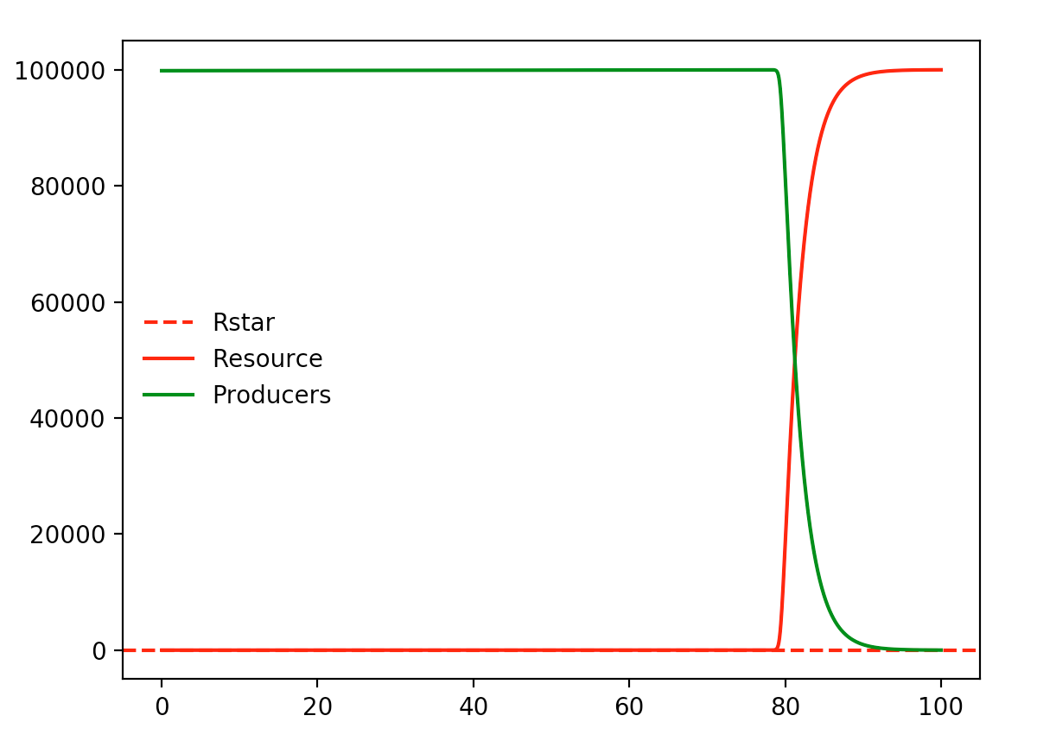
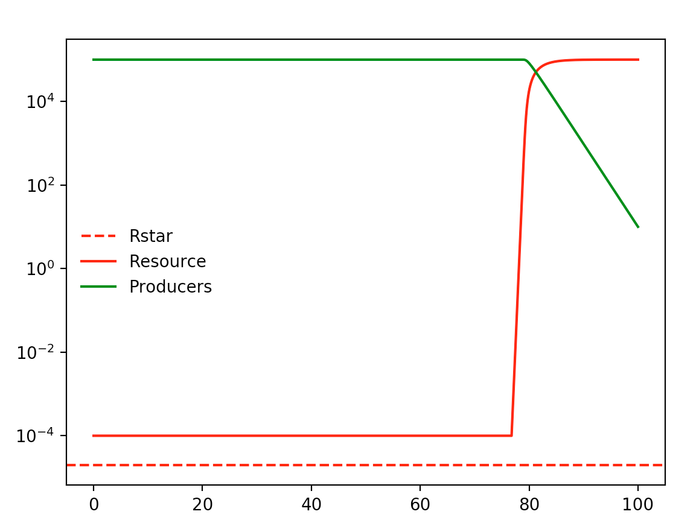
Alpha = 0.00006 Vmax = 0.5

Slide 22
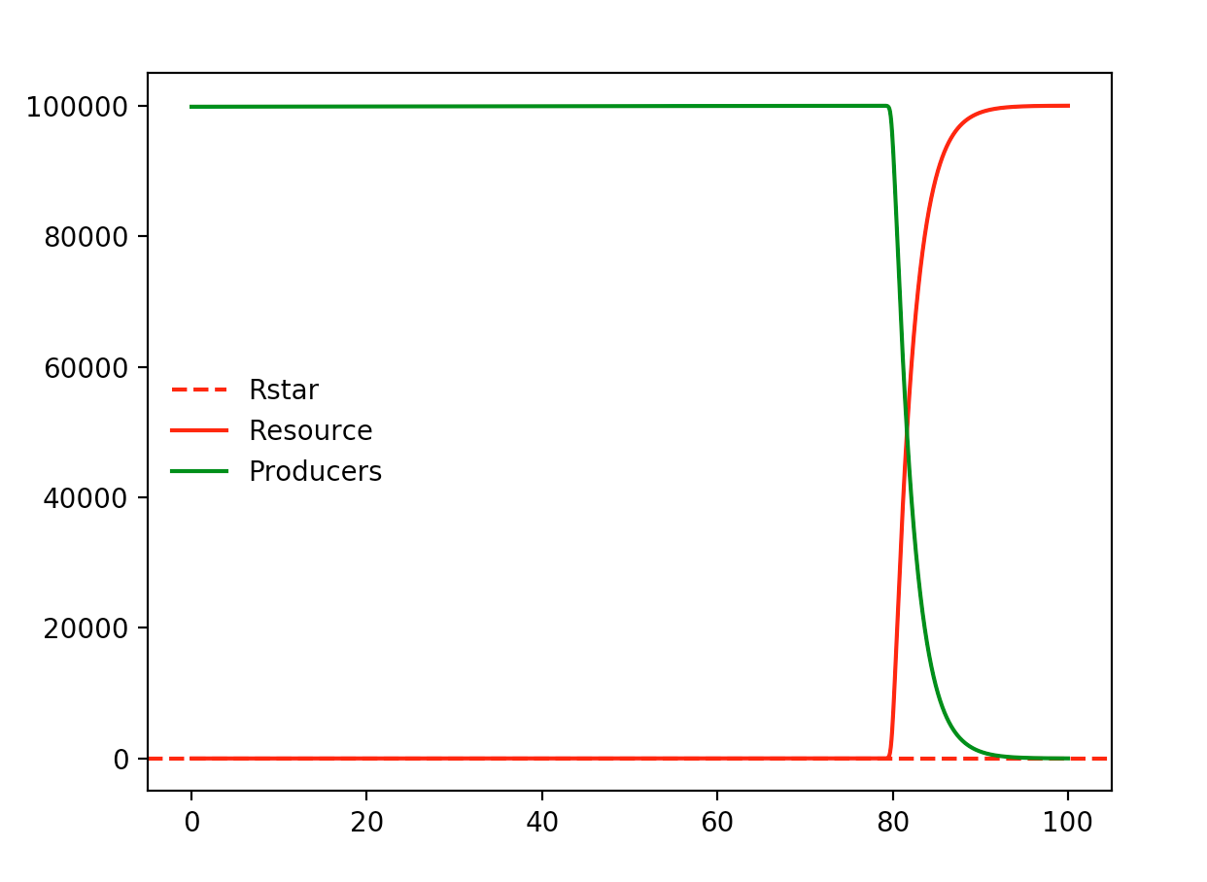
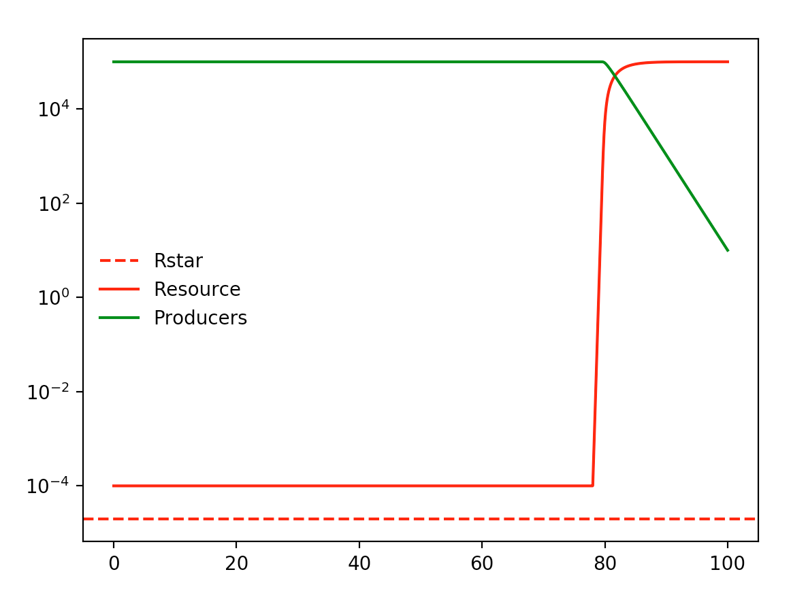
Alpha = 0.00008 Vmax = 0.5

Slide 23
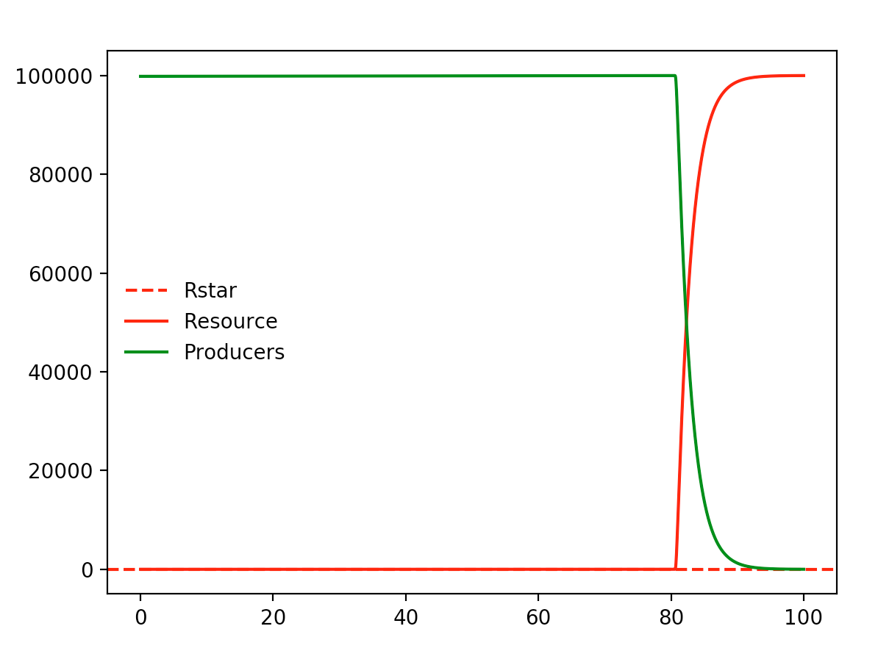
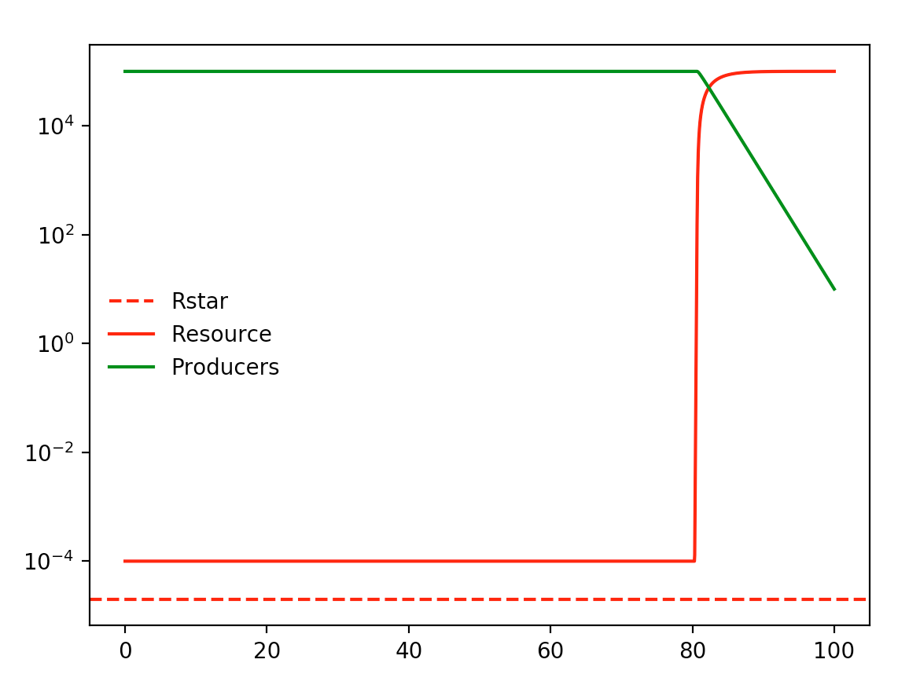
Alpha = 0.0002 Vmax = 0.5

Slide 24
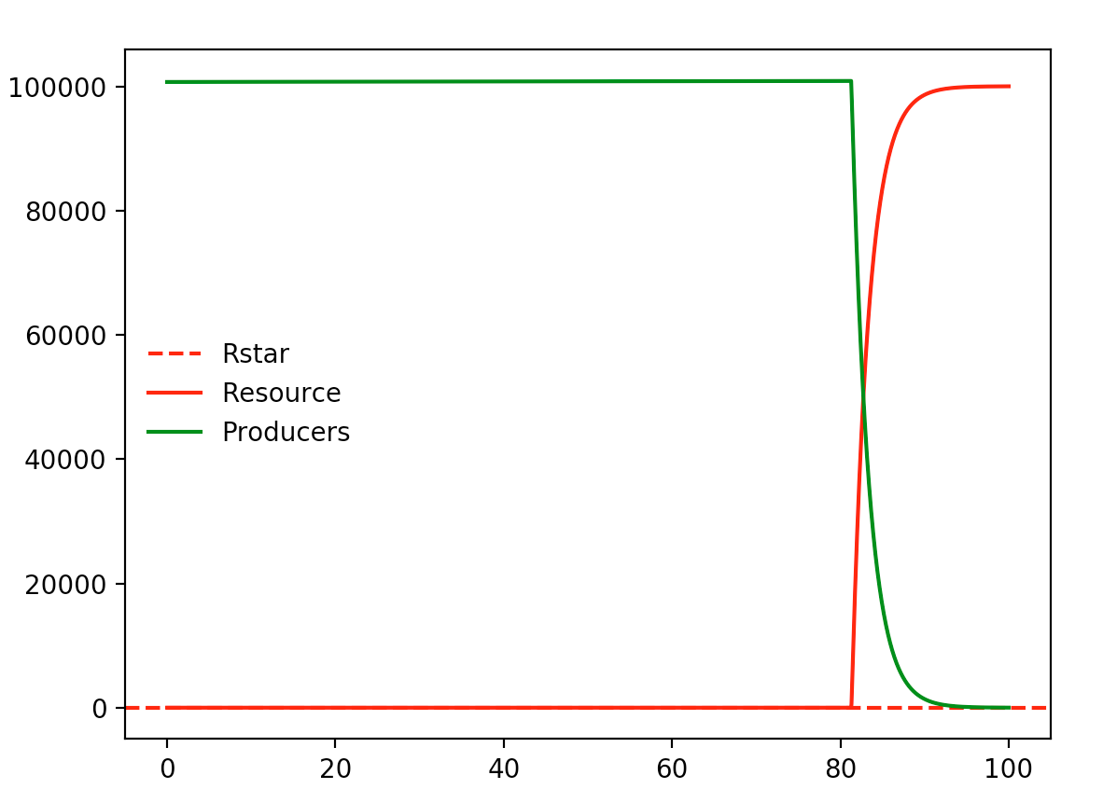
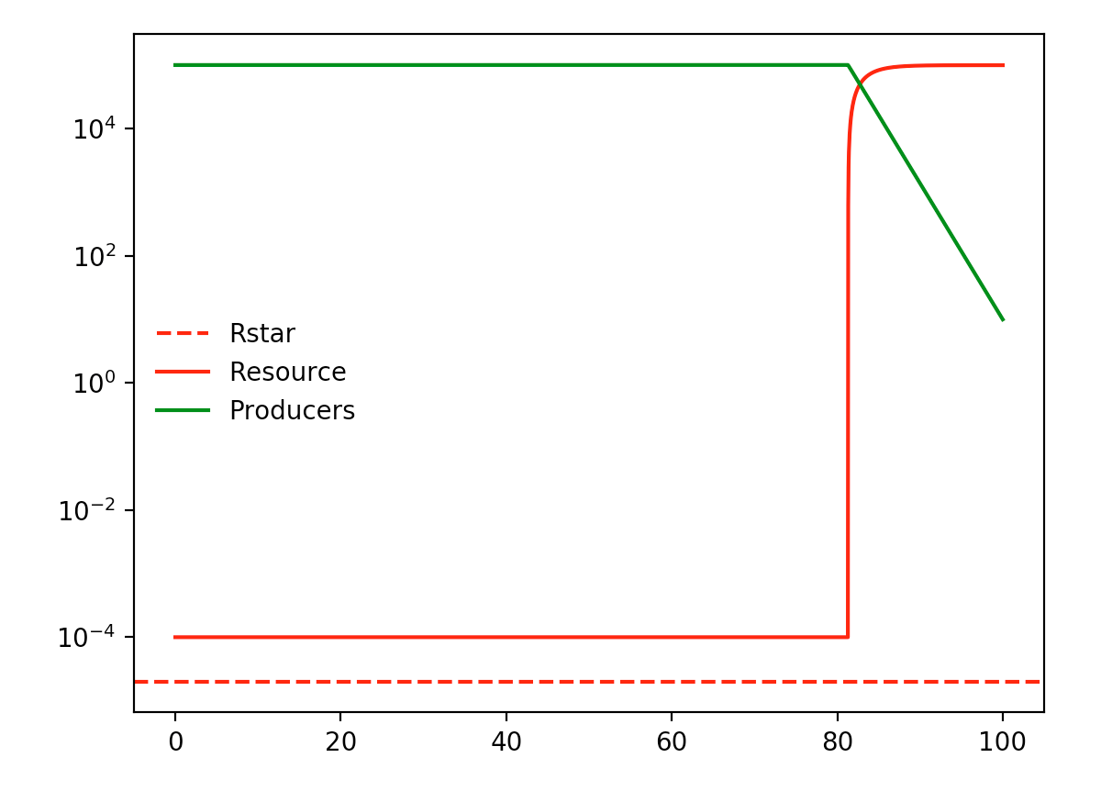
Alpha = 0.002 Vmax = 0.5

Slide 25
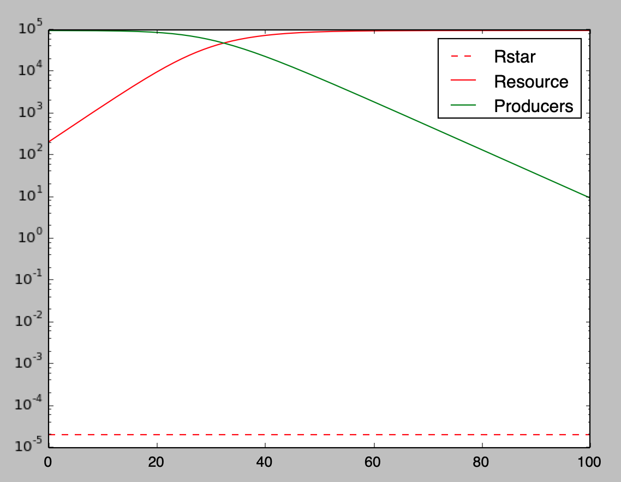
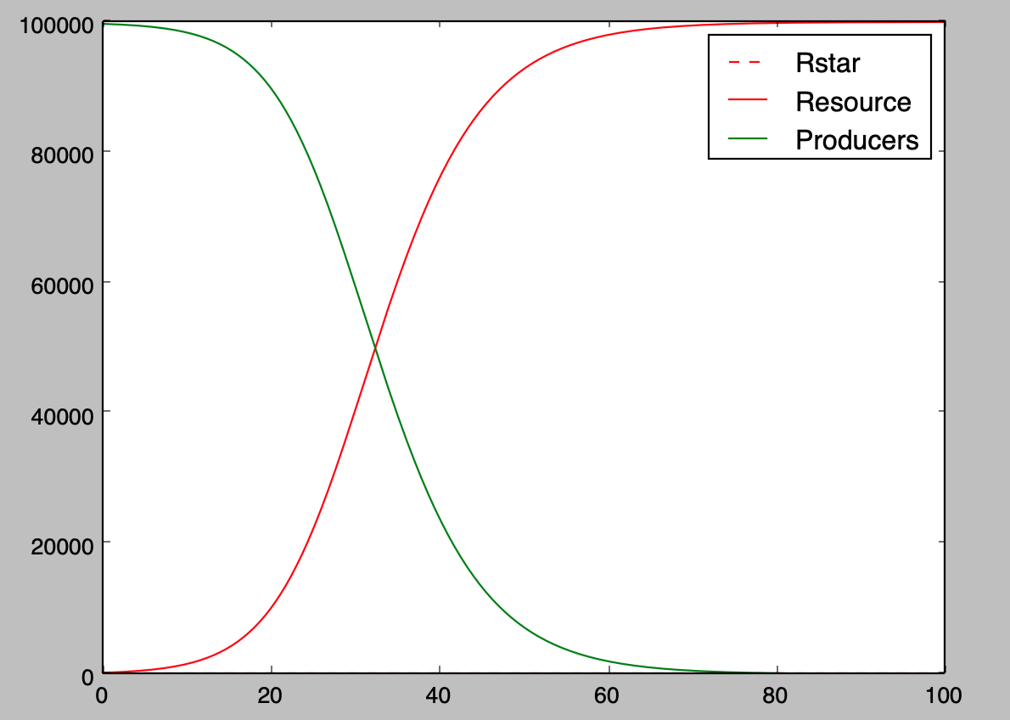
Alpha = 0.000002 Vmax = 0.4

Slide 26
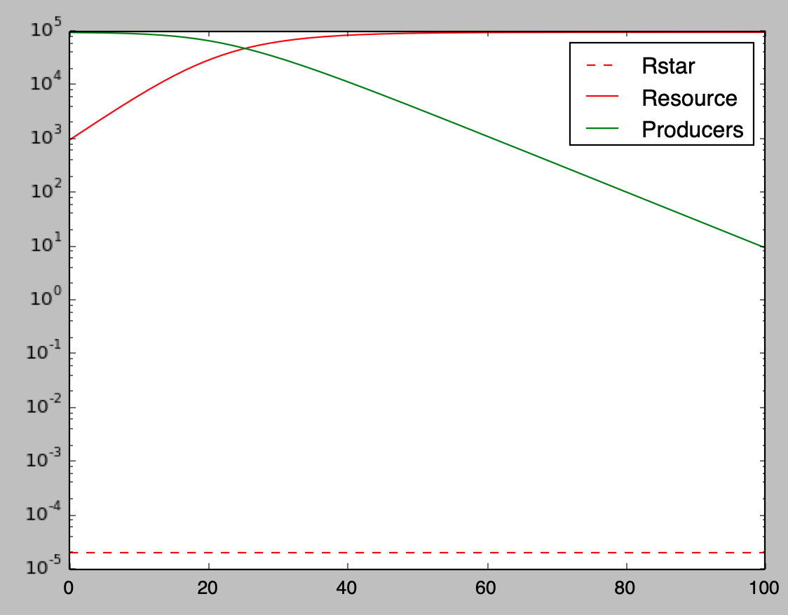
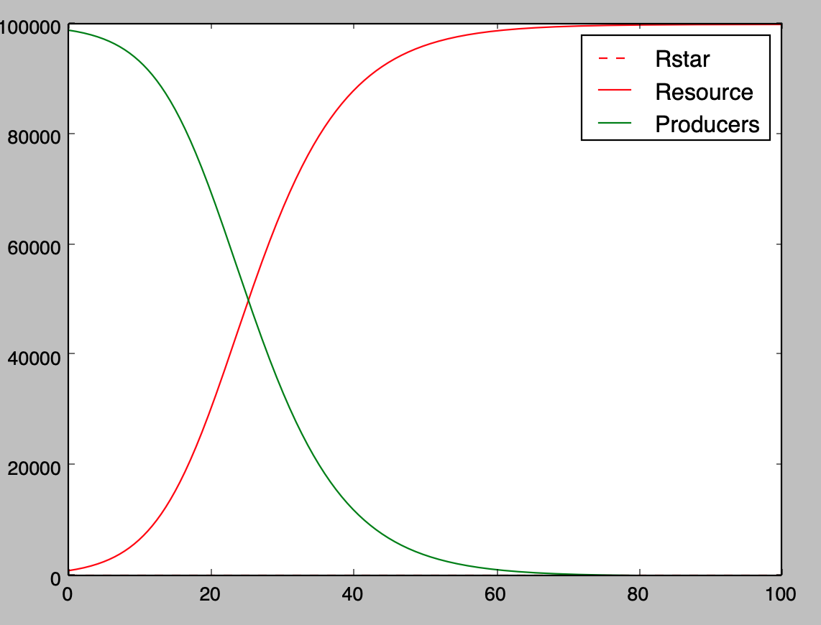
Alpha = 0.000002 Vmax = 0.3

Slide 27
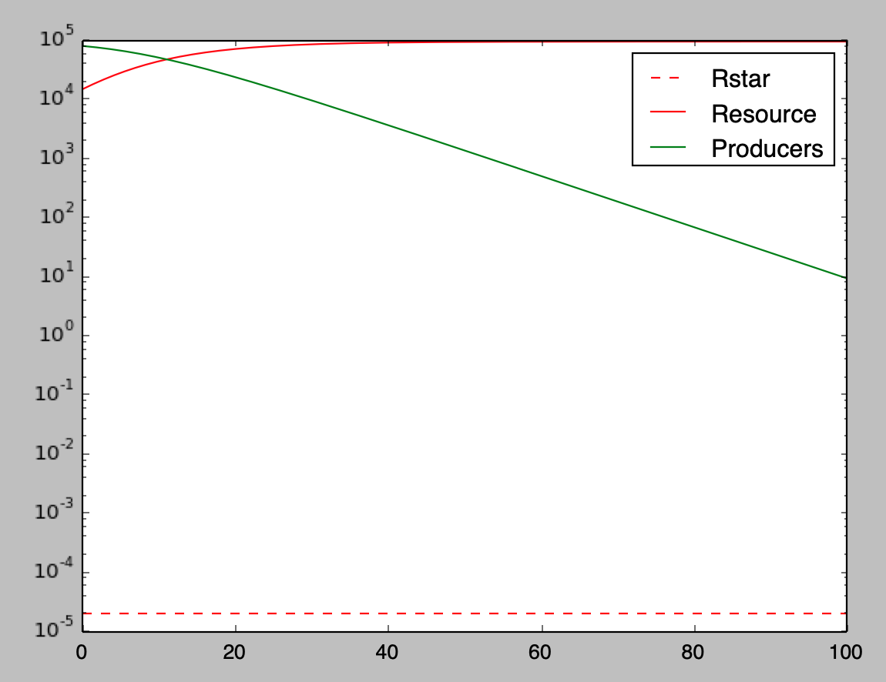
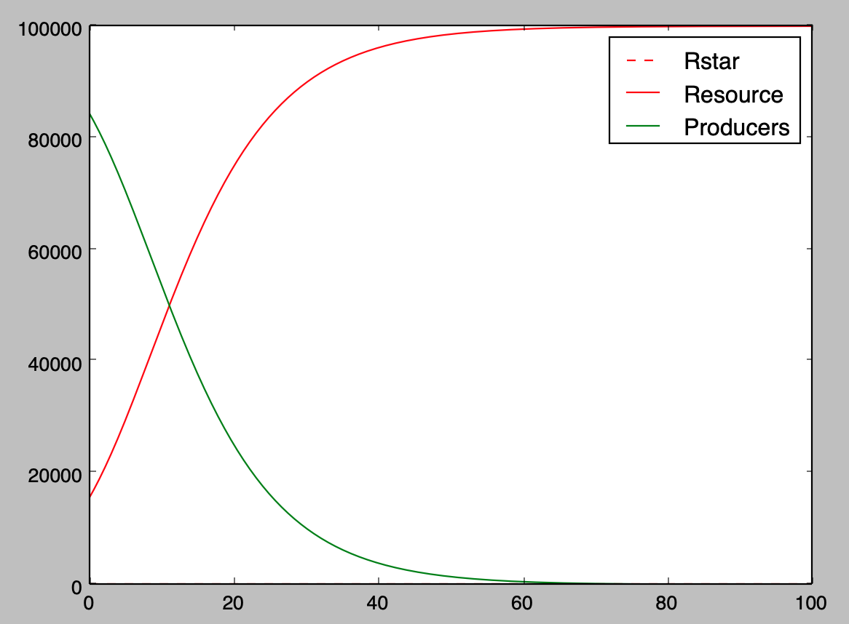
Alpha = 0.000002 Vmax = 0.2

Slide 28
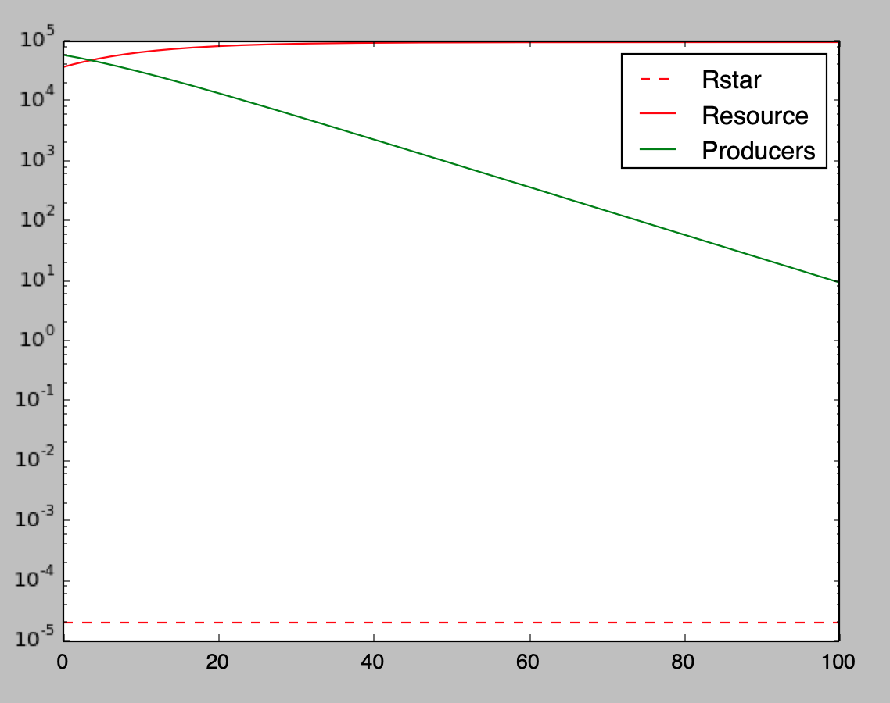
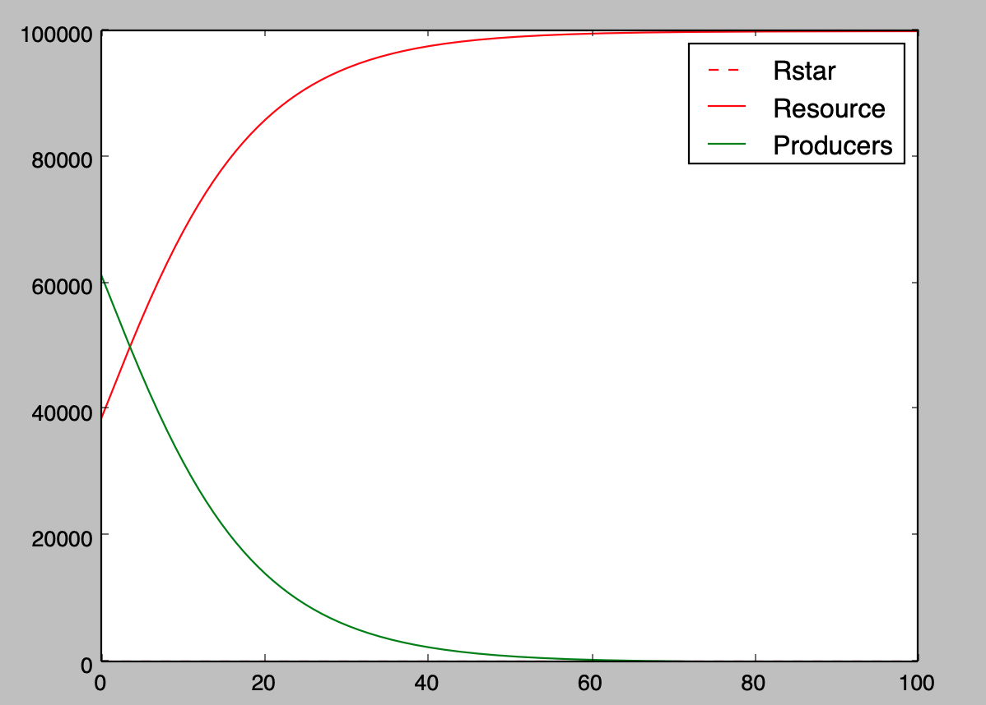
Alpha = 0.000002 Vmax = 0.17

Slide 29
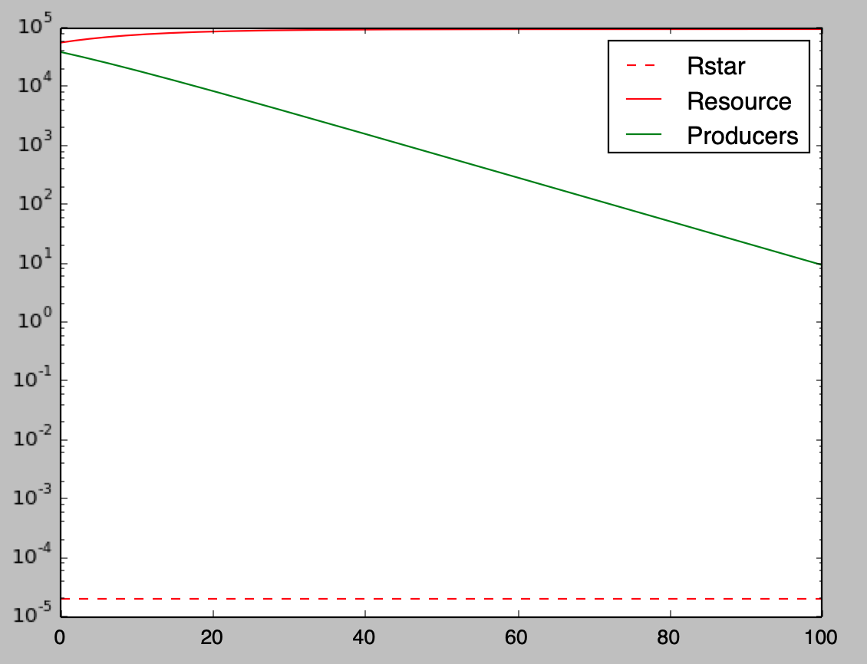

Alpha = 0.000002 Vmax = 0.15

Slide 30


Alpha = 0.000002 Vmax = 0.1

Slide 31


Alpha = 0.000002 Vmax = 0.09

